Slide 1
Air Quality Monitoring
System

Slide 2
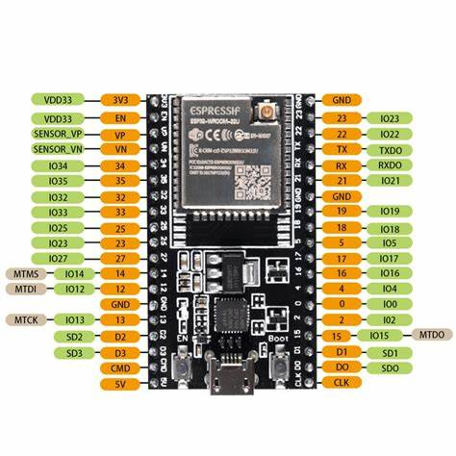
ESP32

Slide 3
The ESP32 is a series of low-cost, low-power system on a chip (SoC) microcontrollers with integrated Wi-Fi and dual-mode Bluetooth.
It’s developed by Espressif Systems, a Chinese company based in Shanghai.
The ESP32 can function as a complete standalone system or as a slave device to a host MCU, reducing communication stack overhead on the main application processor.
It can interface with other systems to provide Wi-Fi and Bluetooth functionality through its SPI / SDIO or I2C / UART interfaces.

Slide 4
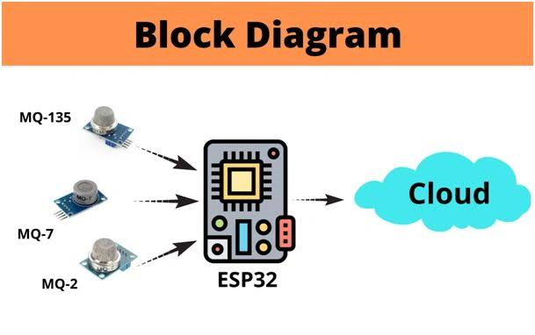

Slide 5
ThingSpeak IoT platform
The project is based on ThingSpeak cloud computing. ThingSpeak is an open source IoT application and API to store and retrieve data from things using HTTP protocol over the Internet via LAN.
It enables the creation of sensor-logging applications, location-tracking applications and a social network of things with status updates. This means, if you send data from the sensors to ThingSpeak at regular intervals, it will create, store and display data in a trend automatically. It has Maths modelling inbuilt in the form of MATLAB documentation, which is free to use.
Account and channel set up. Open an account and a channel on www.thingspeak.com. For this, you need to have a valid email account. The site will send a confirmation email. Click on the link sent in the email to validate your account and create a channel.

Slide 6
From here on, you can create as many channels as you want. The moment you create a channel, you get three ThingSpeak identities: channel ID, write API key and read API key. Note these down, as you will require these in the source program later. Feed up to eight sensor data per channel, such as PM2.5, PM10, temperature, relative humidity, altitude and pressure.
Eight data per channel. Each channel can take eight data signals from different devices. This means, using ThingSpeak API, you can upload eight data per channel, which are eventually gathered, logged and put into trend data by ThingSpeak

Slide 7
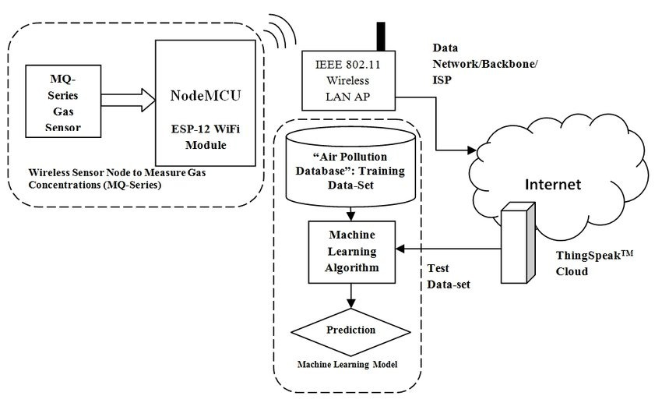

Slide 8
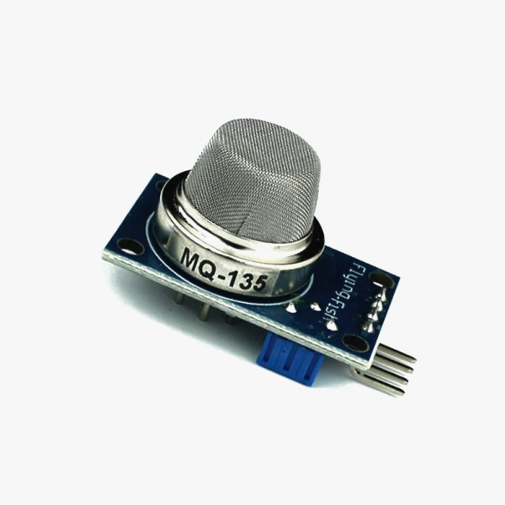
Sensor :
The MQ-135 Gas sensor can detect gases like Ammonia (NH3), sulfur (S), Benzene (C6H6), CO2, and other harmful gases and smoke. Similar to other MQ series gas sensor, this sensor also has a digital and analog output pin. When the level of these gases go beyond a threshold limit in the air the digital pin goes high.

Slide 9
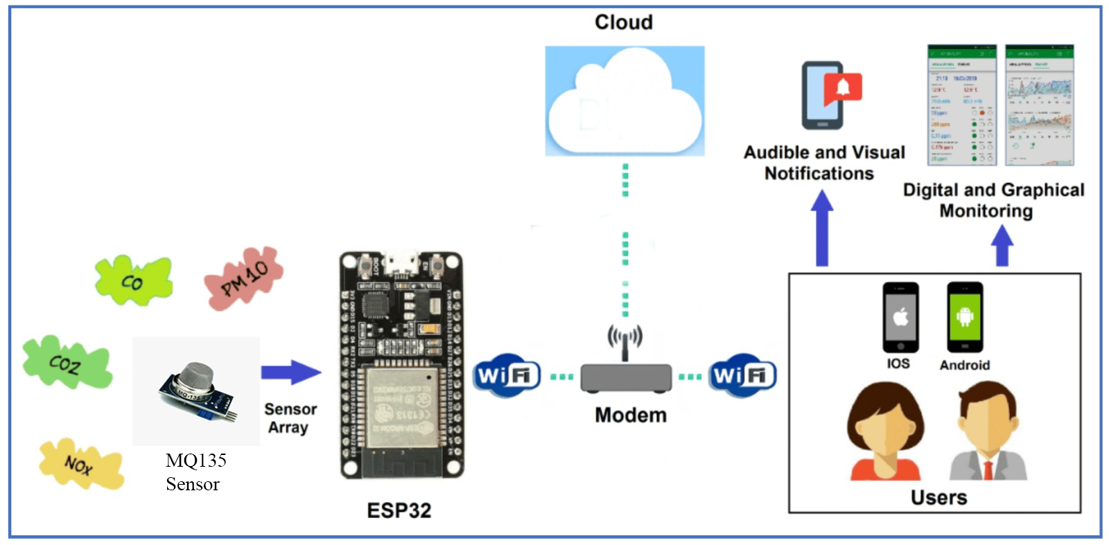
MONITORING AIR QUALITY :

Slide 10
You can monitor the air quality data through the lot platform's web interface or mobile app.
Set up alerts or analytics as needed for better air quality management.
This is a basic guide to get you started with air quality monitoring using ESP32 in an loT project.
Depending on your specific needs, you can expand the project by adding more sensors, improving data processing, or connecting to a more advanced loT platform for more in-depth analysis and control.

